Slide 1





DATA SCIENCE PROJECT LIFE CYCLE
AIRBNB NYC 2023
DIKSHANT MADAI
Student ID :23140738
Email : Dikshant.Madai@mail.bcu.ac.uk

Slide 2

About the dataset-Airbnb NYC 2023
Airbnb, Inc. is an American company that operates an online marketplace for lodging, primarily home stays for vacation rentals, and tourism activities. Based in San Francisco, California, the platform is accessible via website and mobile app.
The dataset that we would be analyzing consists the booking information on Airbnb from 2011 till 2023.

Slide 3


Motivation behind chosen domain
Airbnb is a widely used platform, providing real-world insights into property rental trends in NYC.
What are the average prices for different accommodations and their variations across NYC neighborhoods?
What are the common characteristics of hosts, average listing counts, and prevalent property types?
How are Airbnb listings distributed across NYC neighborhoods?
What is the average availability and how do minimum nights requirements vary across accommodation types and neighborhoods in NYC?

Slide 4

Goals of the chosen Data science Project
Understanding the relationship between different Airbnb
Understanding how the different attributes affect the price in Airbnb

Slide 5




Nature of data collected
Structured
Excel(csv)
Source: Kaggle
Date:2023

Slide 6
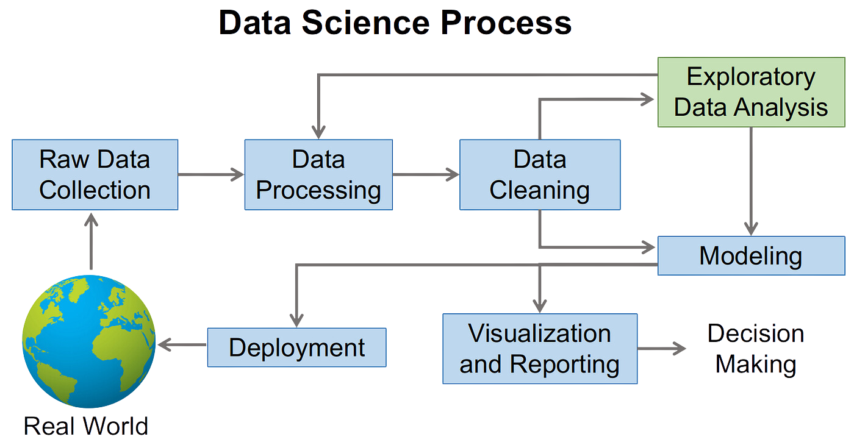
The Data Science Process: How to Turn Data into Insights

Slide 7
Features Description
The features in the dataset can be described as follows:
1. id- This is the identity number of the property listed by a particular host.
2. name - It stands for the name of the property listed by the host.
3. host_id - It is the identity number of the hosts who have registered on Airbnb website.
4. host_name - These are the names of the hosts who have listed their properties.
5. neighbourhood_group - These are the names of the neighborhood groups present in the NYC. Manhattan, Brooklyn, The Bronx, Queens, and Staten Island (boroughs)
6. Neighborhood: These are the names of the neighborhood present in the neighbourhood groups in NYC.

Slide 8
7. latitude - These represent the coordinates of latitude of the property listed.
8. longitude - These represent the coordinates of longitude of the property listed.
9. room type - This represent the various types of room listed by host.
10. price - This is the rent of the property listed in USD.
11. minimum nights - This represent the minimum number of nights customer rented the property.
12. Number_of_reviews - This represent the number of customers reviewed the property.
13. last_review - This represent the date when the property was last reviewed.
14. reviews_per_month - It is the count of reviews per month which the property received.
15. calculated_host_listings_count - It is the number of listings done by a particular host.
16. Availability_365 - This represent the number of days the property is available among 365 days.

Slide 9
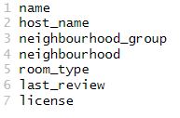
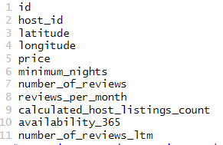
Nature of Attributes
Variable type: character
Variable type: numeric

Slide 10
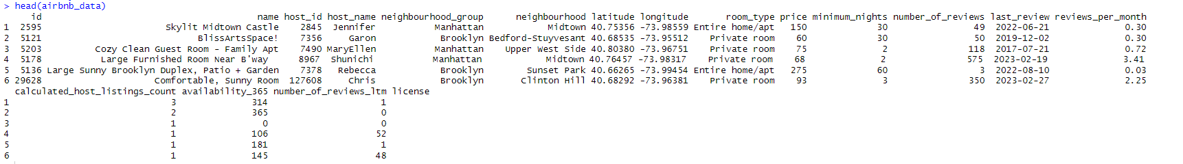
Data Exploration
Checking the first five rows of dataset
The dataset has 42,931 rows and 17 columns.

Slide 11
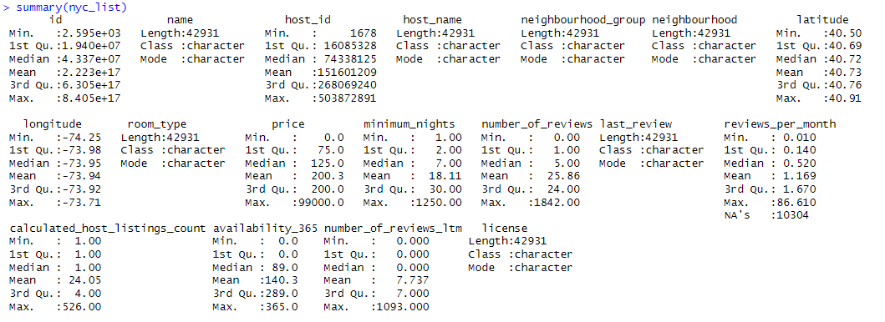
Summary of my Dataset

Slide 12
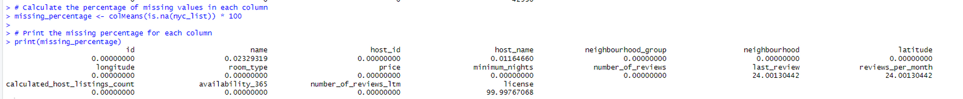
Checking for Null values :
The 'license' column has approximately 99% missing values, the 'number_of_reviews' column has approximately 24% missing values, and the 'reviews_per_month' column also has approximately 24% missing values
The 'name' column has approximately 0.0232% missing values, and the 'host_name' column has approximately 0.011% missing values.

Slide 13
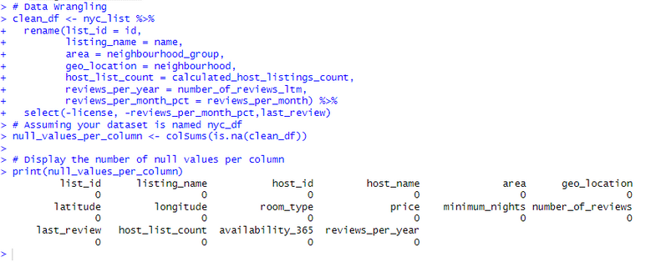
Handling Missing Values and Excluding Unnecessary Columns
Drop the missing rows of listing_name and host_name
Exclude 'reviews_per_month_pct,' 'license,' and 'last_reviews' columns; not needed for my goal
Incomplete Dataset
Complete Dataset

Slide 14
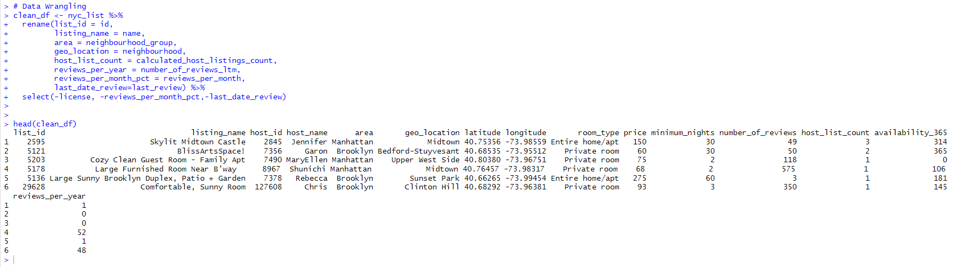
Changing column name
For clarity, the column name has been modified

Slide 15
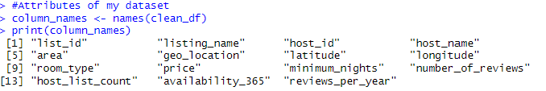
Data Exploration-The Structure
Checking out the 15 features:

Slide 16
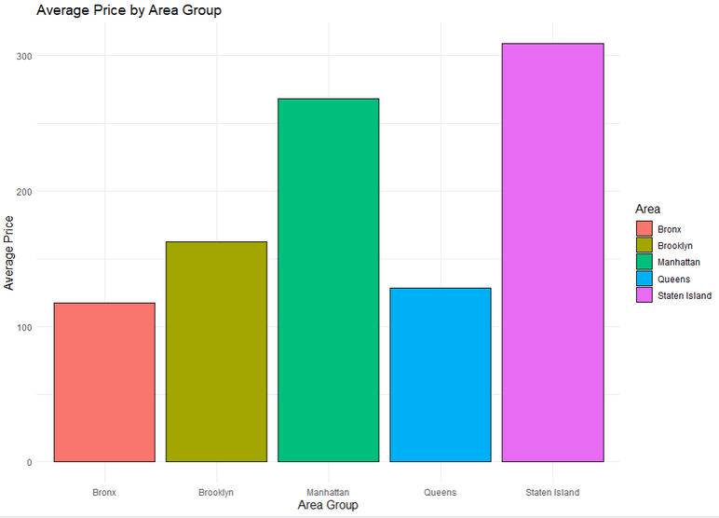
Average prices in different areas of New York City.
The Bronx, Brooklyn, Manhattan, Queens, and Staten Island are each represented by a different color on the graph: red for the Bronx, yellow for Brooklyn, green for Manhattan, blue for Queens, and purple for Staten Island.
Average Price by Area Group" is the title of the graph, and the y-axis represents the average price ranging from 0 to 300.
Insights
The average price on Staten Island is the highest, followed by Manhattan. The average price in Queens is the lowest.

Slide 17
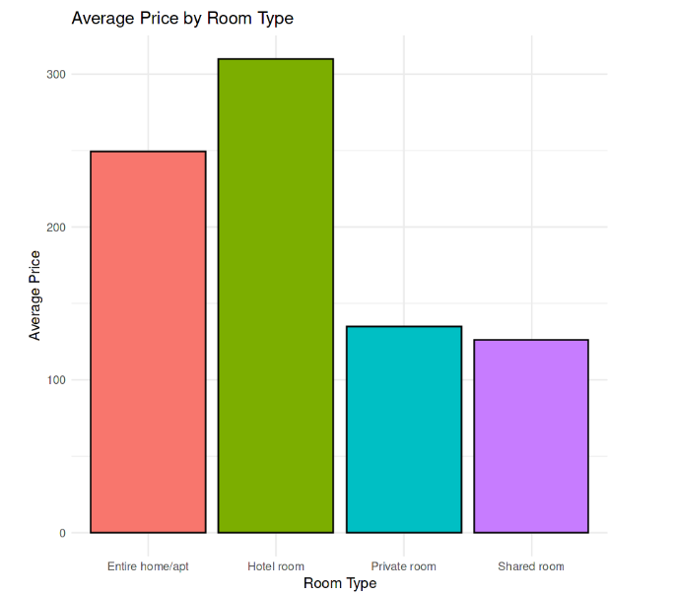
Average prices By Room Type
The graph shows the average price of four types of rooms on Airbnb.
Insights
Hotel rooms are the most expensive room type, followed by entire home/apt. This might reflect the quality, comfort, and privacy of these accommodations.
Shared rooms are the cheapest room type, followed by private rooms. This might reflect the affordability, accessibility, and availability of these accommodations.

Slide 18
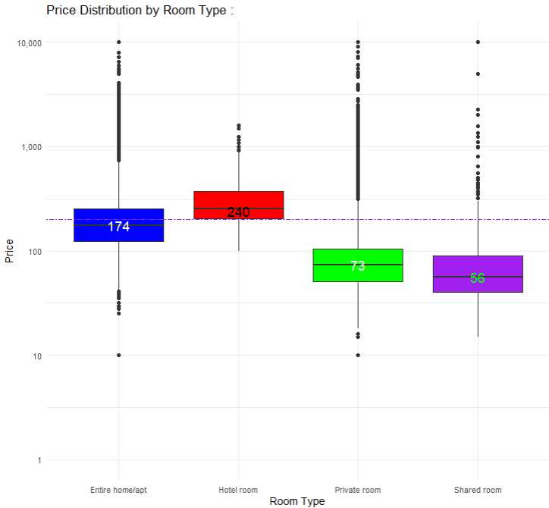
Analyze Airbnb prices by room type
The visualization is a box plot of prices by room type on Airbnb.
The y-axis is logarithmic and shows the prices from 1 to 10,000.
The boxes show the IQR and median of prices for each room type; the lines show the full range of prices; the circles show the outliers.
Insights
Hotel rooms are the most expensive and have the widest price range; shared rooms are the cheapest and have the narrowest price range.
To make predictions, one could use regression models with factors like location and more.

Slide 19
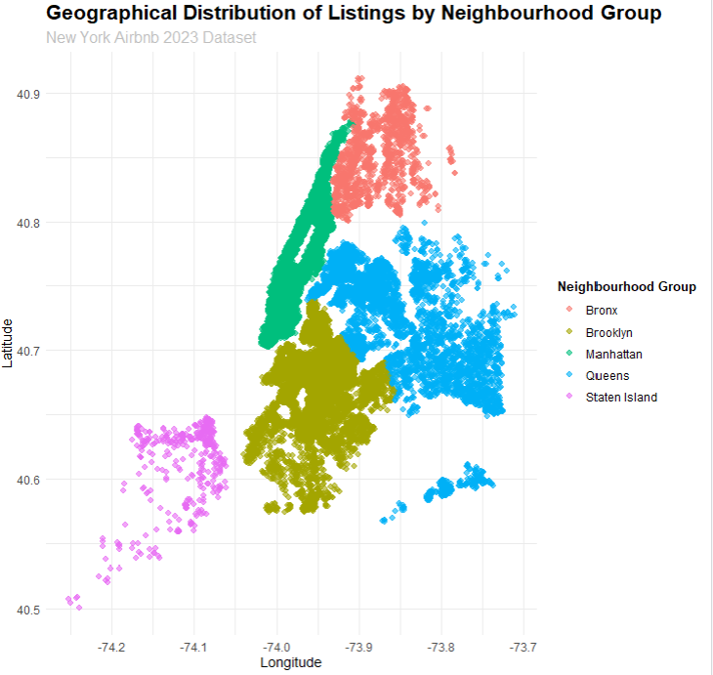
Geographical Distribution of Listing by Neighborhood Group
You will see a scatter plot where each point represents a listing in New York City. The x-axis will show the longitude, the y-axis will show the latitude, and the points will be scattered based on the corresponding geographical coordinates. what are the insight that i will get from these
Insights
Geographical Distribution: You can see how the listings are distributed across different areas of New York City, such as Bronx, Brooklyn, Manhattan, Queens, and Staten Island. You can also see the concentration and density of listings in each area.

Slide 20
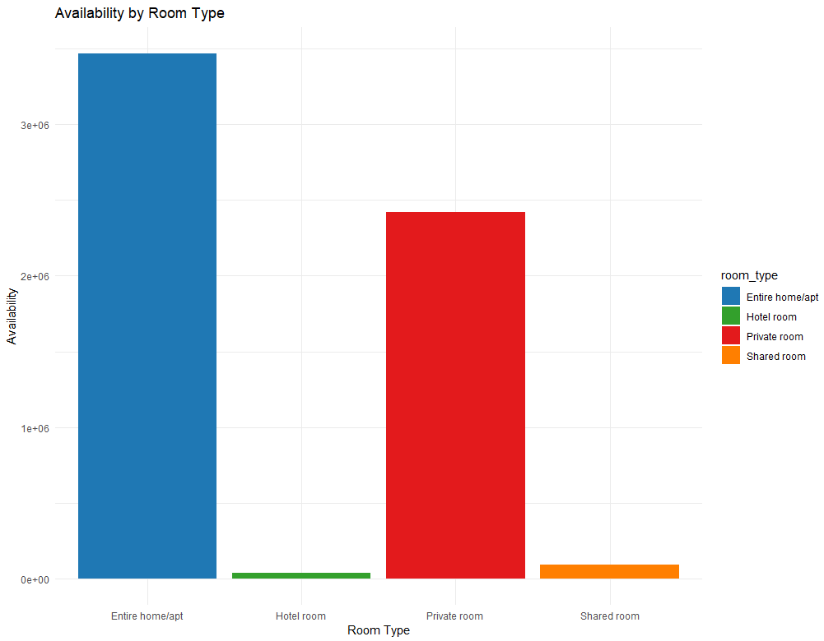
Room Type Availability
The graph shows the availability of four room types on Airbnb: Entire home/apt, Hotel room, Private room, and Shared room.
Insights
Entire home/apt is the most available, followed by Private room. Hotel room and Shared room are the least available.

Slide 21
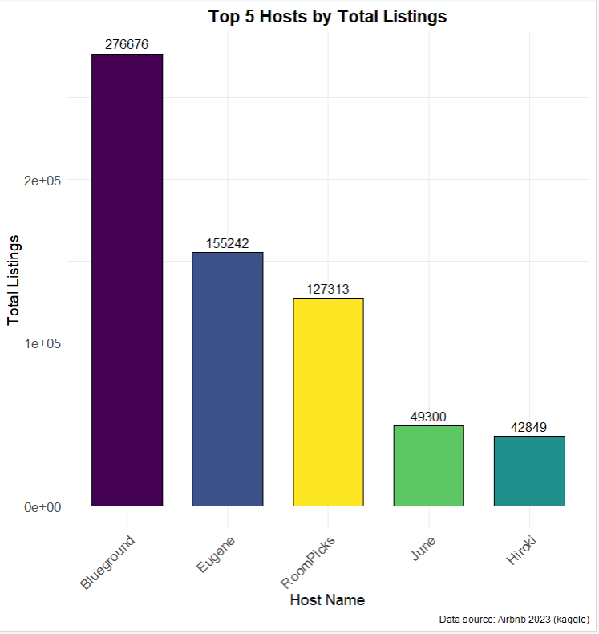
TOP 5 Hosts by Total Listing
The graph shows the number of listings for top five hosts on Airbnb: Blueground, Eugene, Hitoki, June, and RoomPicks.
Insight
Blueground has the most listings, followed by Eugene. RoomPicks,June,Hitoki, and have much fewer listings.

Slide 22
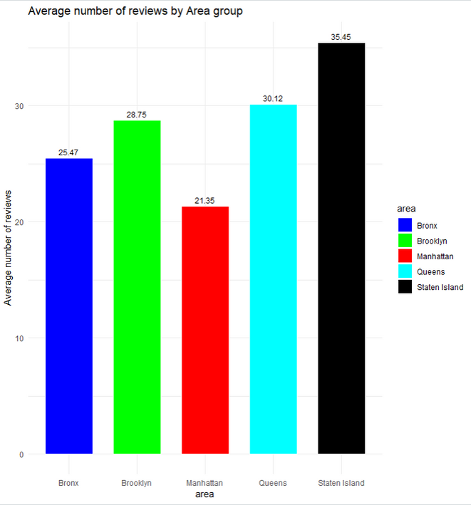
Average number of reviews by Area Group
This visualization is a bar plot that shows the average number of reviews by area group in New York City’s five boroughs
Staten Island has the highest average number of reviews with 35.45 reviews per listing, followed by Queens with 30.12 reviews per listing.
Manhattan has the lowest average number of reviews with 21.35 reviews per listing, followed by Bronx with 25.47 reviews per listing.
Brooklyn is in the middle with 28.75 reviews per listing, slightly higher than the overall average of 27.53 reviews per listing.
There is a large variation in the average number of reviews among the five boroughs, ranging from 21.35 to 35.45, indicating different levels of popularity and demand for Airbnb listings in different areas.

Slide 23
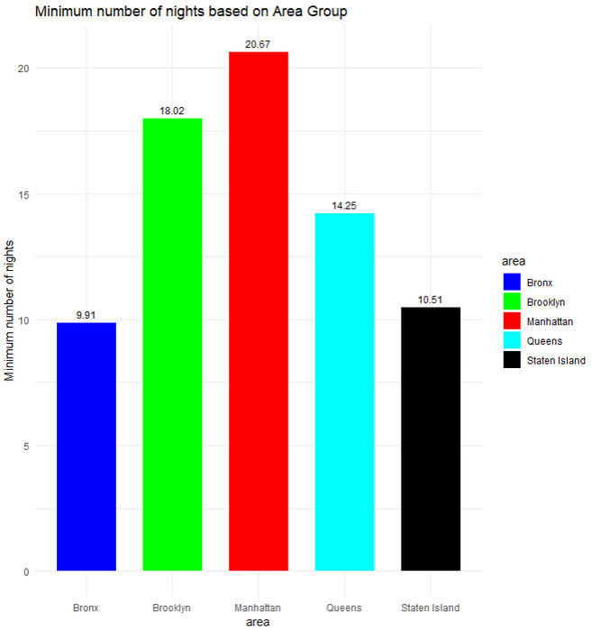
Minimum number of nights based on
Area Group
This is a graph that shows the average minimum number of nights for Airbnb listings in different areas of New York City
Insights
We can now see the average minimum number of nights that a guest must stay in an Airbnb before they can rent it; Manhattan has the highest minimum number of nights, at roughly 20, while the Bronx has the lowest, at roughly 10.

Slide 24
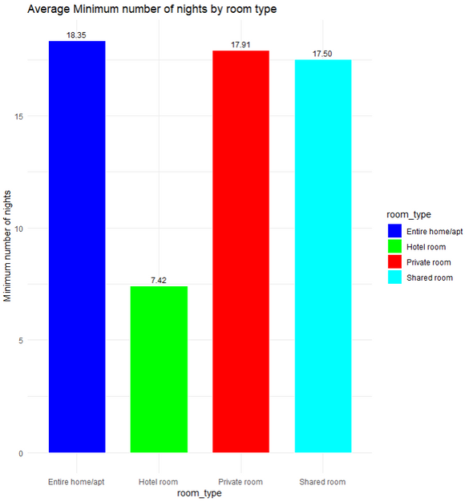
Average Minimum number of nights by room type
This visualization is a bar graph that shows the average minimum number of nights required for different types of rooms on Airbnb in New York City
Insights
Entire home/apt requires the longest stay with an average of roughly 18 nights
Hotel room requires the shortest stay with an average of roughly 7 nights
Private room and shared room have similar stays

Slide 25
Result and Finding
For Host:
1.Optimal Pricing Strategy: Hosts can set competitive prices by analyzing average prices in different areas, enabling them to make informed decisions on market positioning.
2. Room Type Selection: Hosts can strategically choose room types based on demand and average prices, potentially offering entire homes or apartments for higher profitability and shared rooms for budget-friendly options.
3. Geographical Focus: Hosts can enhance visibility and booking opportunities by focusing on neighborhoods with higher listing concentrations, aided by understanding geographical distribution.
4. Availability Management: Hosts can adjust listing availability based on room popularity, potentially optimizing offerings in high-demand categories to attract more guests.
5. Competitive Analysis: Top hosts' listing numbers offer valuable market competition insights, allowing hosts to benchmark their performance, learn from their strategies, and potentially enhance their own success.

Slide 26
6. Review Optimization: Hosts can boost guest satisfaction and increase the popularity and demand for listings by focusing on areas with higher average review numbers.
7. Minimum Nights Strategy: Hosts can adjust their minimum nights based on local preferences, such as longer stays in Manhattan or shorter nights in the Bronx, to attract different guests.
8. Room Type Duration Optimization: Hosts can match their minimum stay requirements with guests' preferred durations for each room type, potentially increasing booking rates.
For Airbnb:
1. Optimal Pricing Strategy: Utilize the insights on average prices in different areas to set competitive pricing strategies, adjusting rates based on neighborhood demand and characteristics.

Slide 27
2. Room Type Offerings and Pricing Strategy: Tailor room offerings and pricing based on the identified trends in room types. Emphasize marketing and service quality for hotel rooms, while ensuring affordability and accessibility for shared rooms.
3. Predictive Modeling for Price Optimization: Utilizing regression models, which consider location and room type, can help predict and optimize prices, thereby maximizing revenue and ensuring competitive pricing.
4. Strategic Listing Placement: Analyze geographical listings distribution to understand concentration and density, then strategically position new listings based on demand and competition in each neighborhood.
5.Inv﻿entory Management: The focus is on enhancing room availability by understanding demand and adjusting offerings to meet market preferences, ensuring a balanced supply of various room types.

Slide 28
6. Host Relationship Management: Identify top Airbnb hosts and collaborate closely to improve the experience, offering support, incentives, and recognition to maintain positive partnerships with high-performing hosts.
7.Popularity and Marketing Focus: Strengthen branding and promotion in regions with higher average reviews to attract more guests and direct marketing efforts towards these areas..
8. Adapt Minimum Stay Policies:The policy should be adjusted based on local market trends and guest satisfaction, taking into account local dynamics to boost bookings.
9.Differentiated Room Type Strategies: Customize marketing and operational strategies based on minimum night requirements for room types, promoting flexibility for shorter stays and longer stays for entire home/apartment options.

Slide 29
Conclusion
The dataset underwent comprehensive cleaning, including renaming, data type adjustments, and Exclude the unnecessary column.
EDA unveiled insights on NYC average prices by area, room type analysis for Airbnb prices, geographic distribution by neighborhood group, room type availability, top 5 hosts by total listings, average reviews by area group, minimum nights based on area group, and average minimum nights by room type.
Visualizations provided clear and concise representations of key findings, aiding in better understanding and decision-making.

Slide 30
Strategic Hosting Decisions: Airbnb hosts can enhance their experience by setting competitive prices, matching room offerings with demand, and concentrating on high-demand neighborhoods.
Competitive Edge through Analysis: Analyzing competitive insights, top hosts, and market trends allows hosts to benchmark their performance and adapt strategies for success.
Enhanced Visibility and Bookings: Geographical concentration and availability management tactics can maximize visibility and booking opportunities, helping hosts attract more guests.
Review and Satisfaction Optimization: Hosts can improve their popularity by focusing on areas with higher average review numbers, enhancing guest satisfaction, and encouraging positive reviews.

Slide 31
Tailored Minimum Nights Strategy: Adapting minimum nights based on area insights allows hosts to cater to diverse audience preferences, optimizing stay durations for increased bookings.
Airbnb Strategic Recommendations: Airbnb can leverage insights for strategic decisions, including tailored pricing strategies, differentiated room type offerings, and predictive modeling for price optimization.
Marketing and Popularity Focus: Directing marketing efforts towards popular areas and collaborating with top hosts can strengthen Airbnb's presence and appeal to a wider audience.
Adaptive Policies for Success: Airbnb can enhance overall customer satisfaction by adapting minimum stay policies based on area groups, catering to diverse market expectations.

Slide 32
References
Images
The Data Science Process :
https://miro.medium.com/v2/resize:fit:828/format:webp/1*03D9umtAeoGnFXYH-Ycm8A.pngt
2. Bedroom Photo:
https://www.pexels.com/photo/photo-of-bedroom-3209035/

Slide 33


